Slide 1
Analysis of Stroke using Tableau
Anita Adhikari
02/05/2024

Slide 2
Introduction
Bachelors’ degrees
Microbiology (2011)
Medical Laboratory Science (2022)
Medical Laboratory Scientist -5 yrs
Master’s in Business Analytics- 2023

Slide 3

Stroke
Common and substantial health challenge in the US and throughout the world
Leading cause of death in the US (cdc.gov, 2023)
Heart attack every 40 seconds
1 in 5 stroke occurrence are silent (Tsao CW, 2023)
Deaths from cardiovascular disease surged 60% globally from 12.1 million in 1990 to 20.5 million in 2021 (World Heart Federation, 2023)

Slide 4
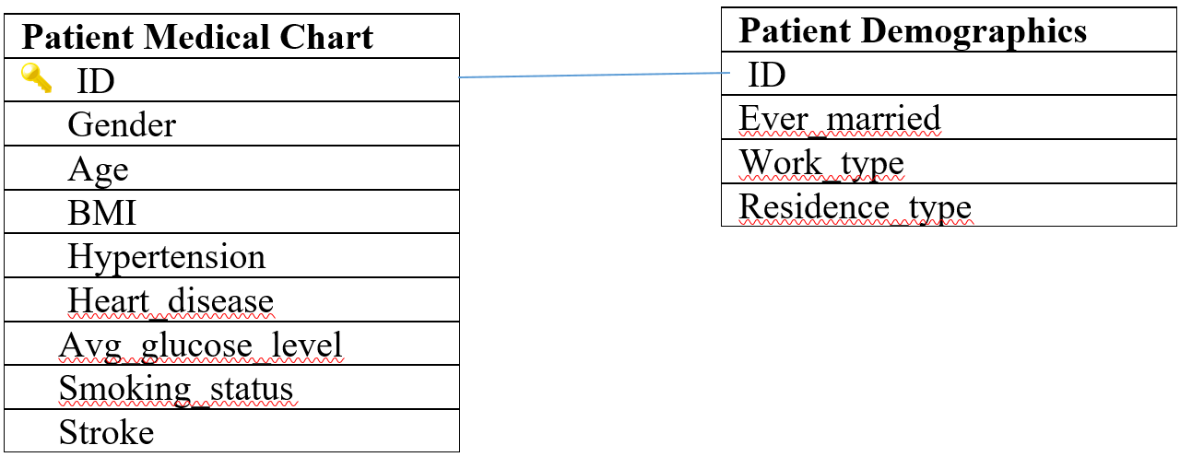
Dataset
Stroke dataset from Kaggle

Slide 5
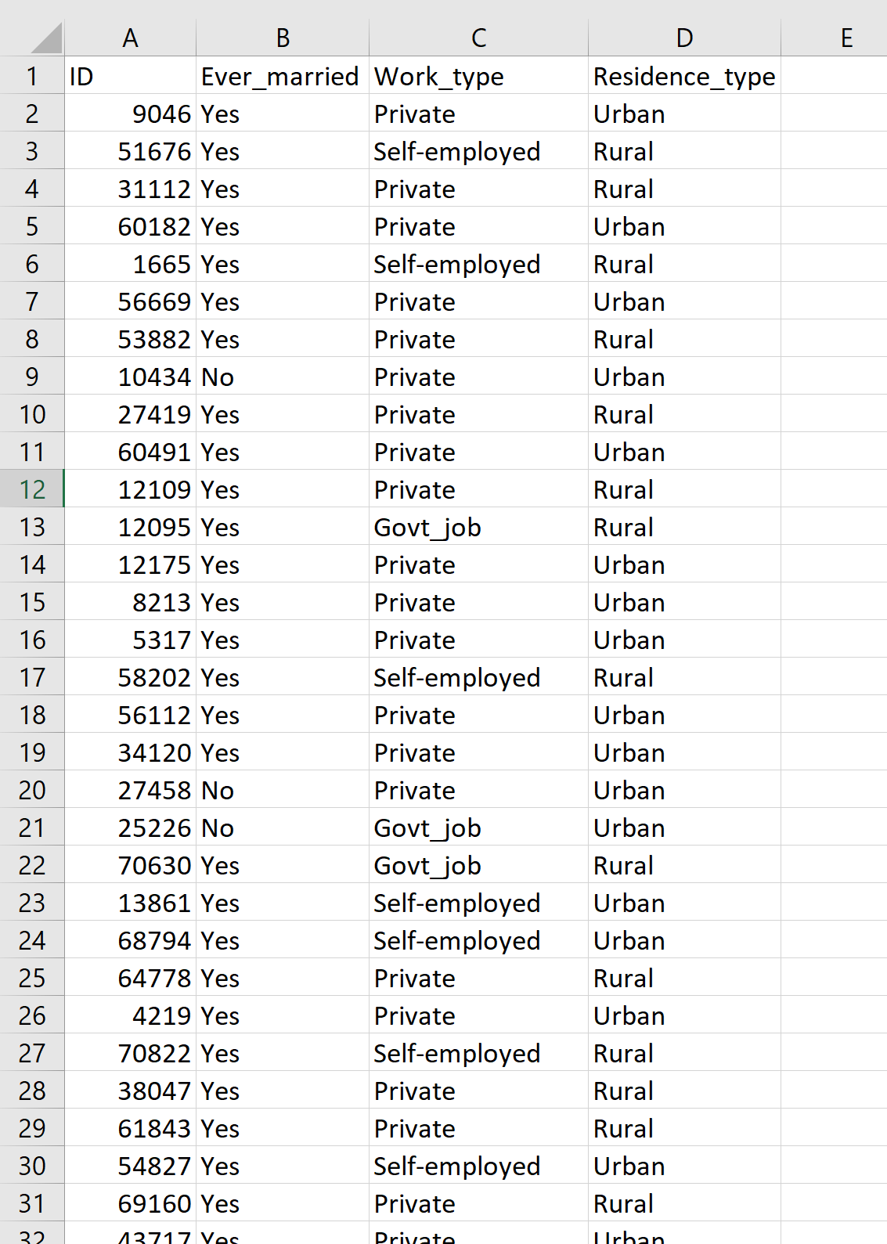
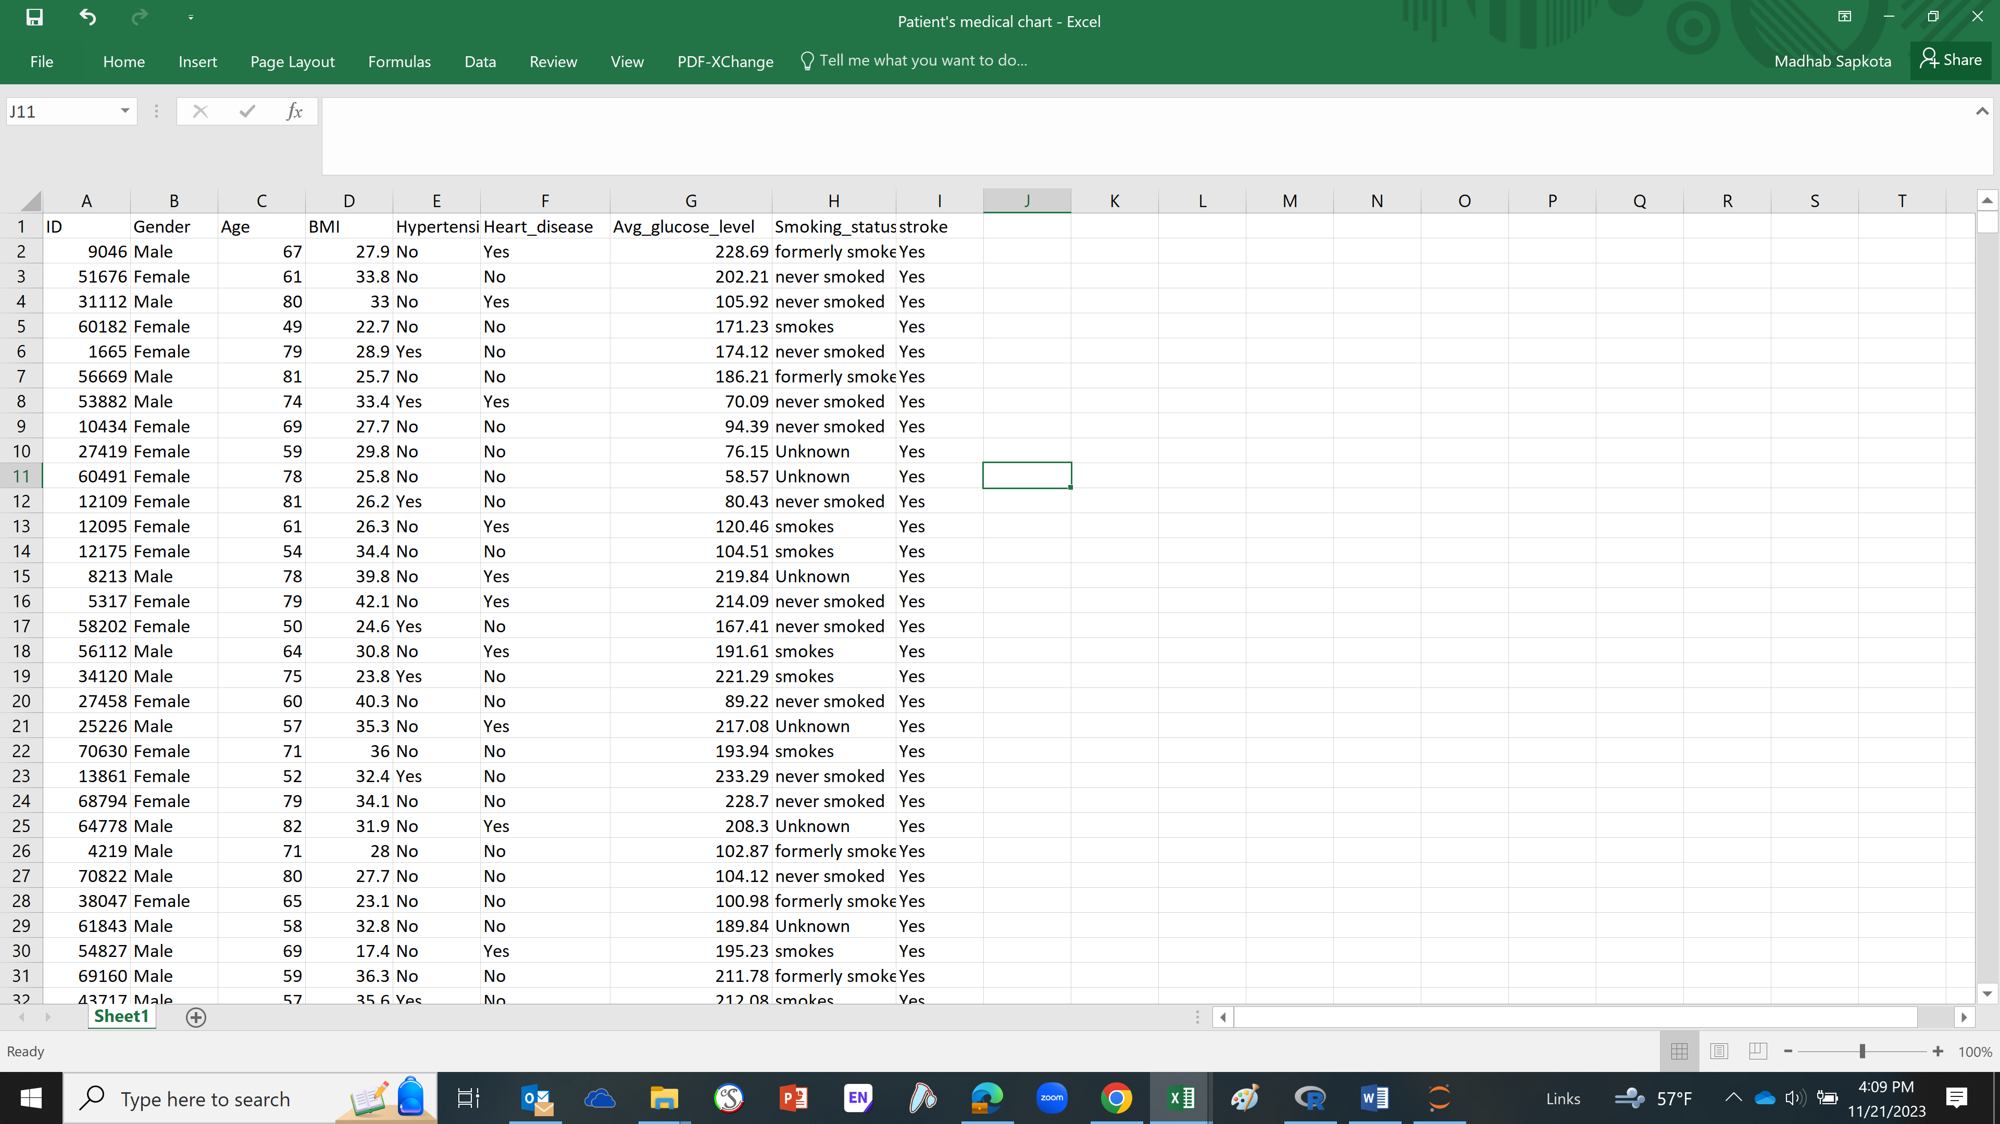
Dataset in Excel Sheets

Slide 6
Data preprocessing
Created a bin for age by grouping age by 10 years
0-10, 10-20, 20-30, 30-40, 40-50, and so on
Created calculated fields
Calculated glucose level
Avg glucose level <90 = ‘Low Glucose’
Avg glucose level between 90 to 139 = ‘Normal Glucose’
Else = ‘High Glucose’
BMI Index
BMI< 18.5 = 'Underweight'
BMI between 18.5 AND 24.0 = 'Ideal'
ELSE = 'Overweight'

Slide 7
Data Preprocessing (Contd.)
Implied Group by function to merge smokes and formerly smoked categories into one single category
Facilitates data analysis based on patients who never smoked, smokes/formerly smoked and unknown.

Slide 8
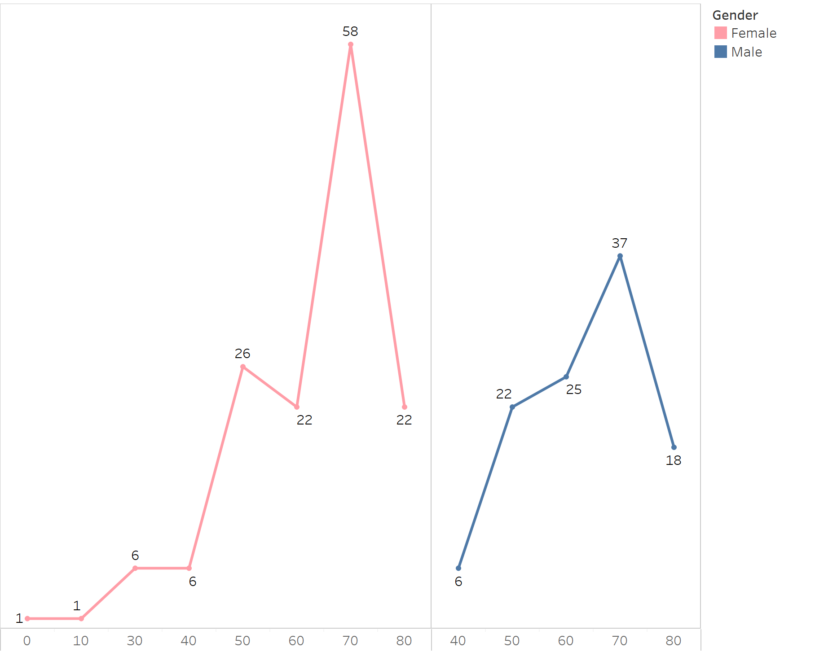
Age Groups and Gender

Slide 9
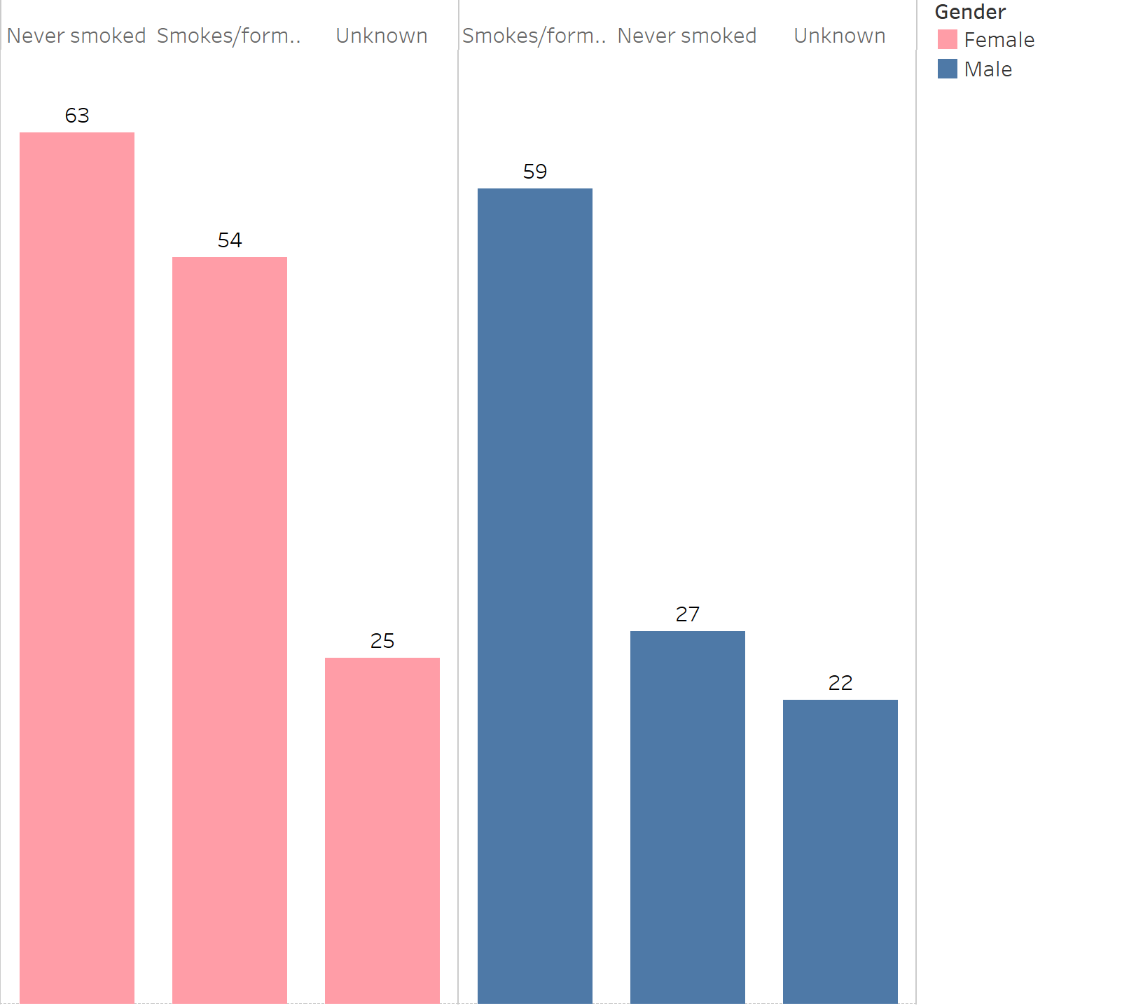
Gender and Smoking Status

Slide 10
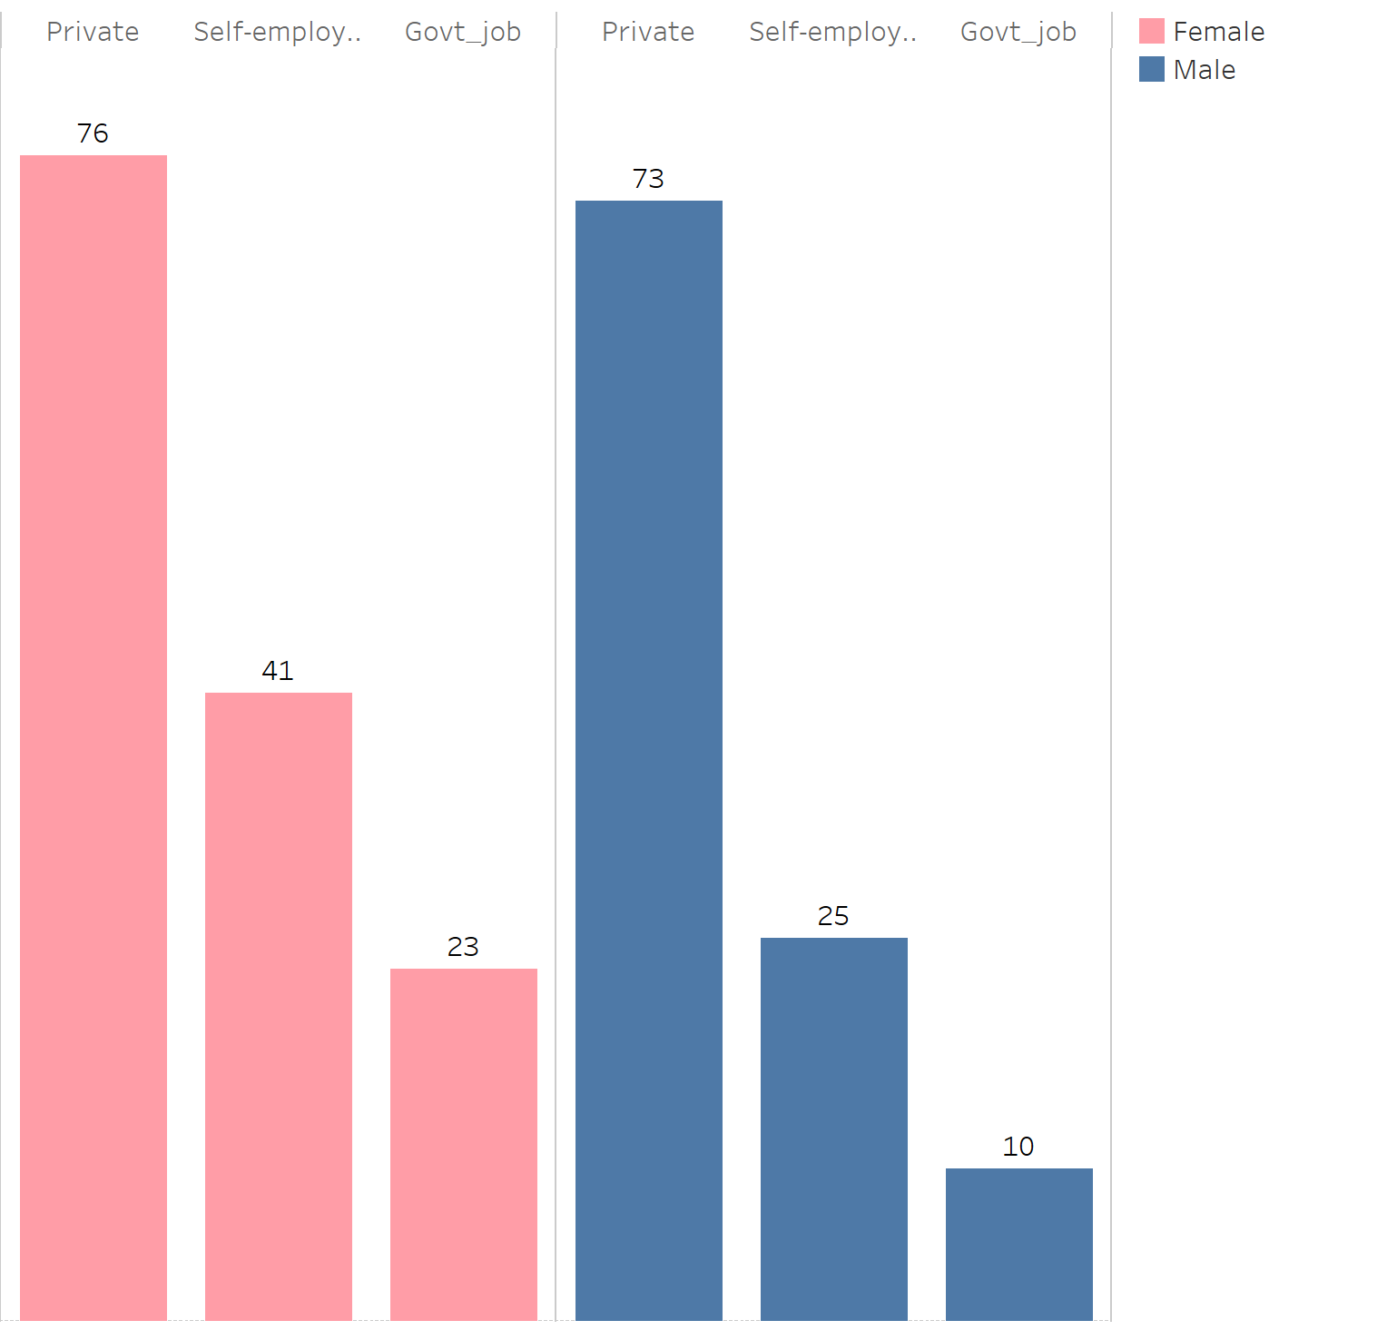
Gender and Work Type

Slide 11
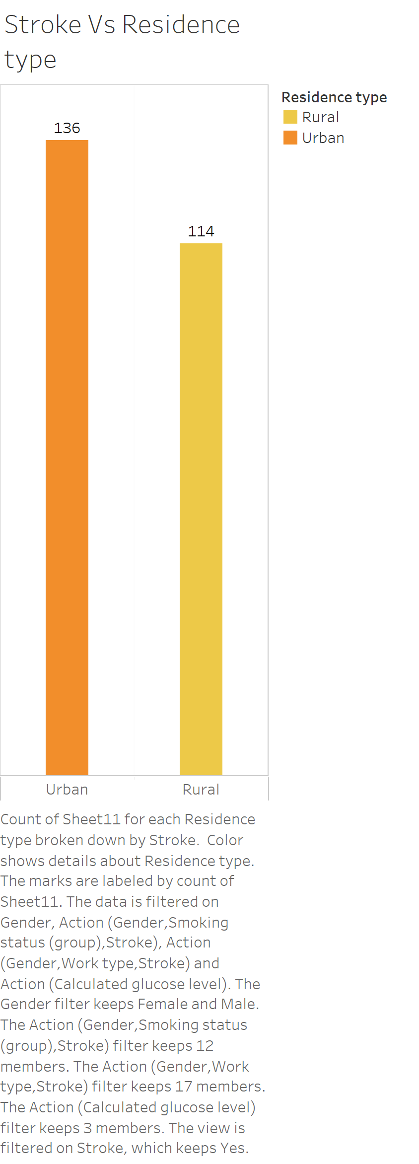


Stroke vs Residence Type

Slide 12
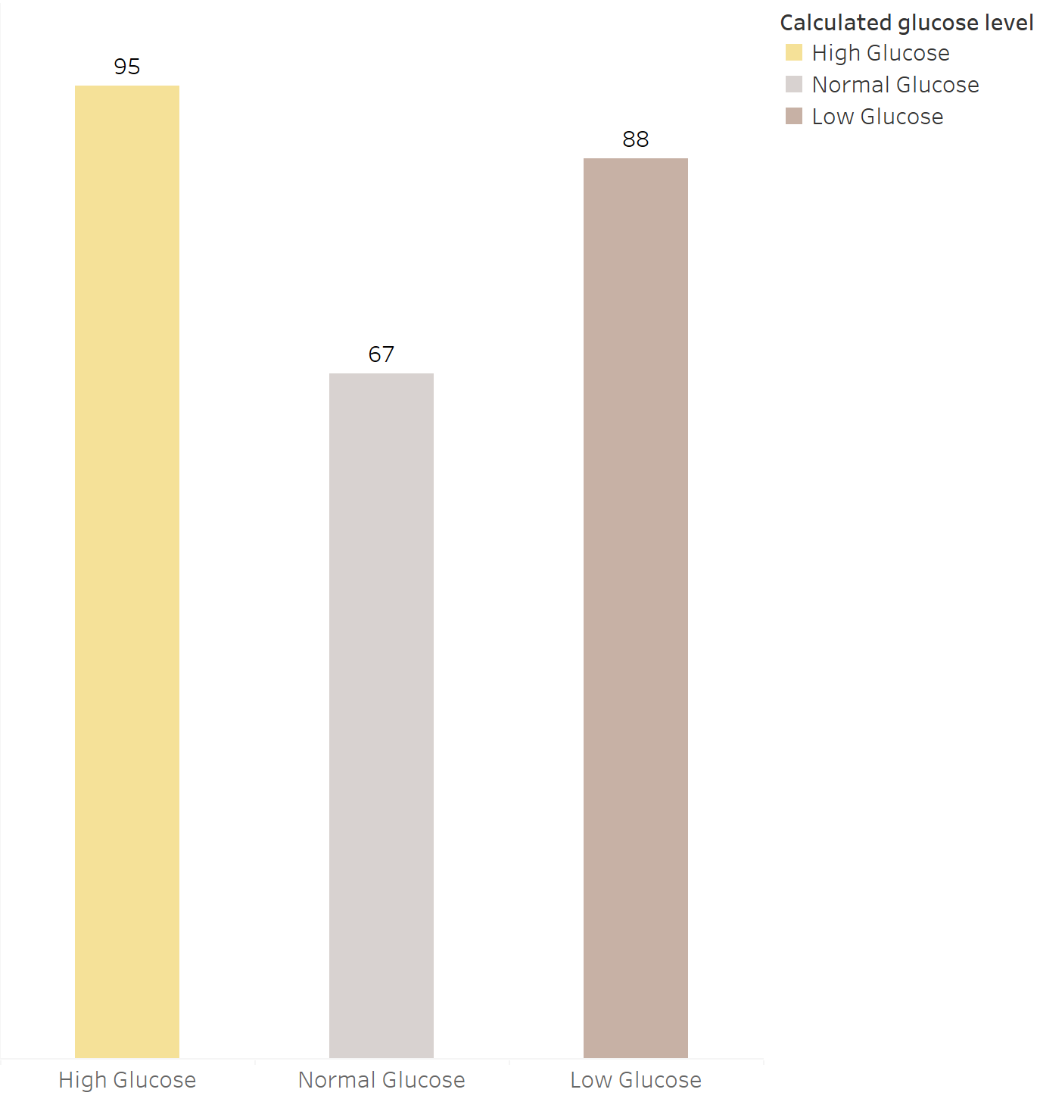
Stroke vs Glucose Level

Slide 13
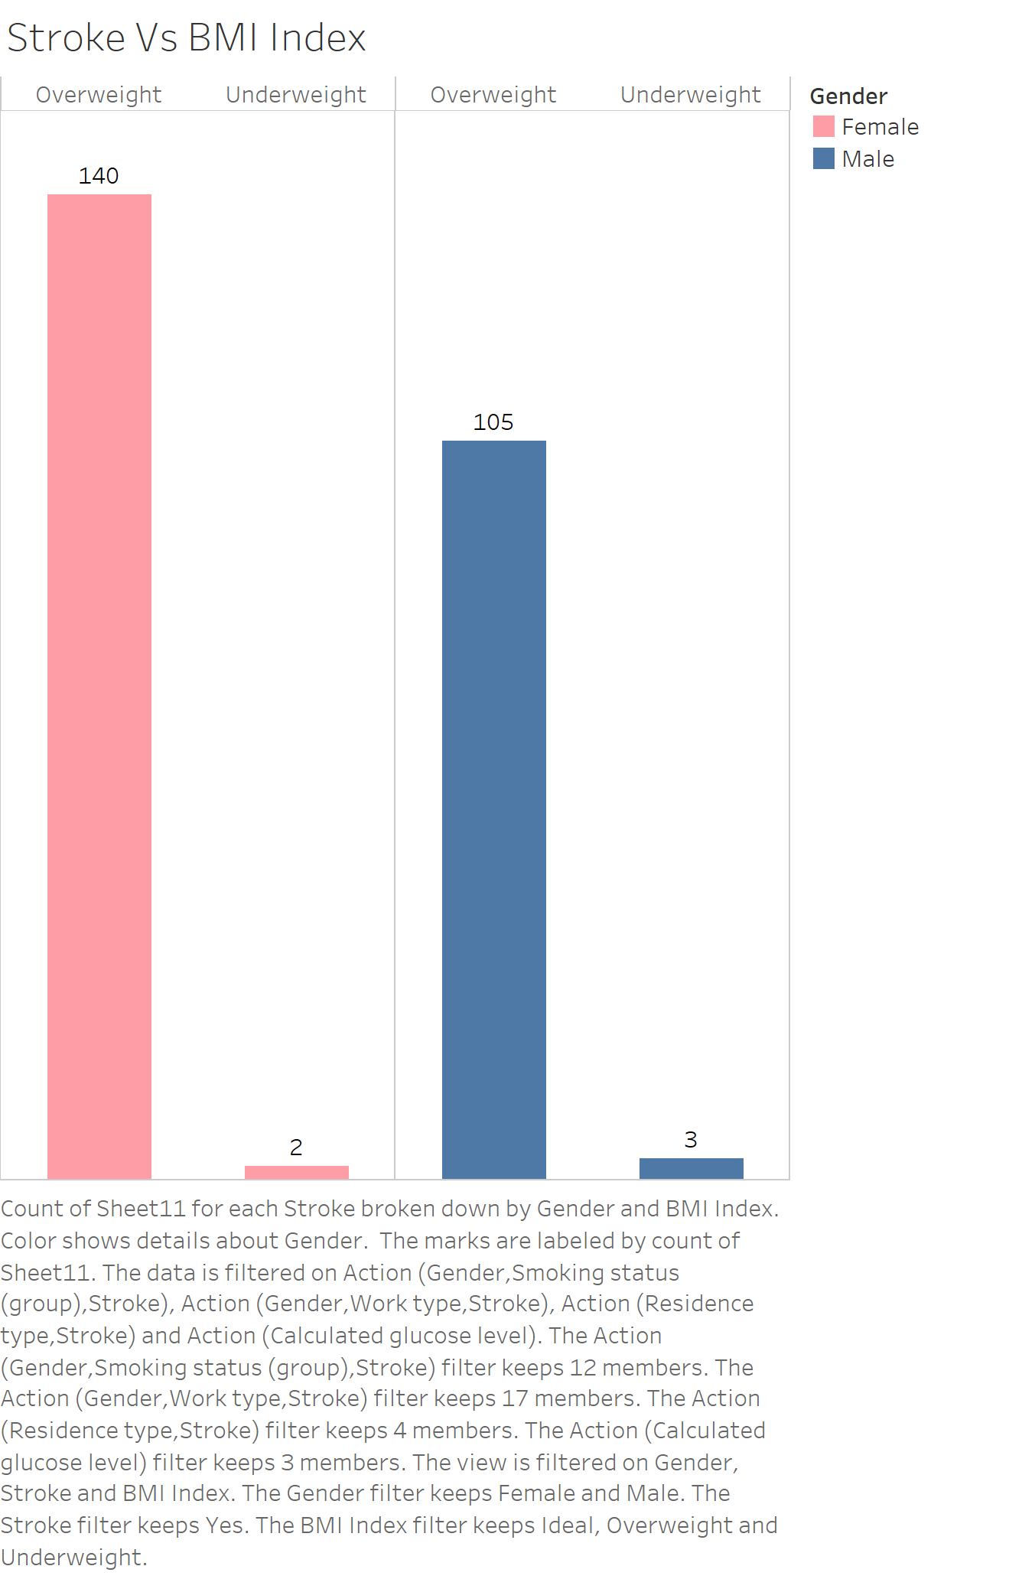
Stroke vs BMI Index

Slide 14
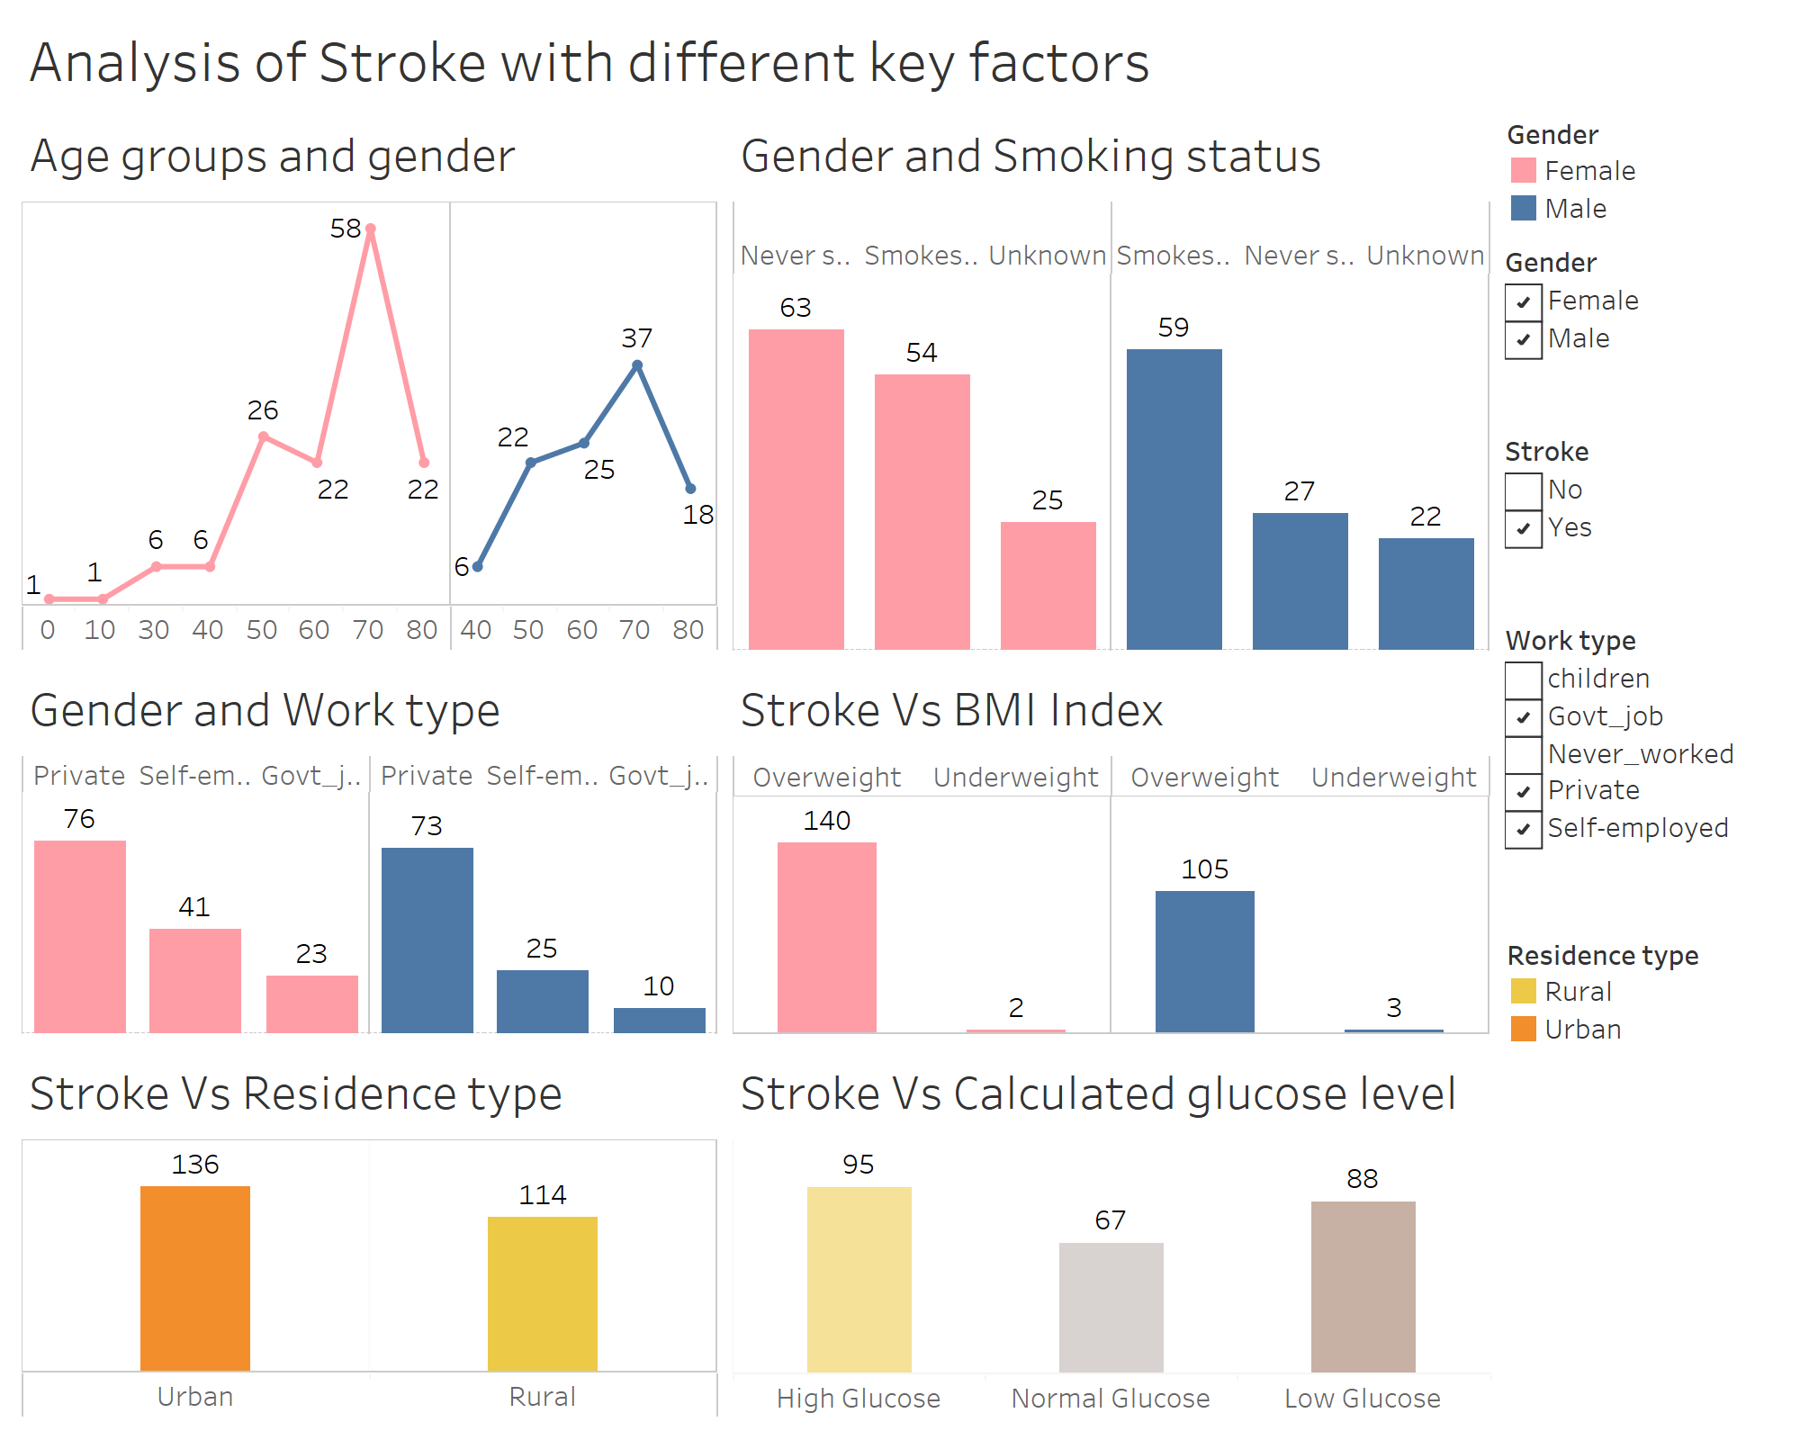
Analysis of Stroke with Different Key Factors-Dashboard

Slide 15
Conclusion
Higher incidents of stroke related to:
Age group 50 and above for both males and females
Males who currently smokes or smoked in the past and females who never smoked
Individuals working in private companies
Are overweight based on BMI
Living in urban areas
Individuals with high blood glucose levels

Slide 16
Thank you!

